Slide 1
PP6: Heritable Traits
Year 10 Science

Slide 2
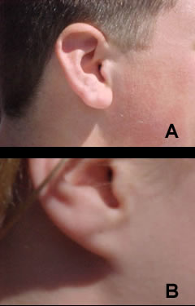
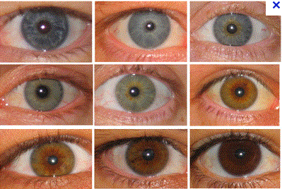
Ear lobes
Free or attached
Eye Color

Slide 3
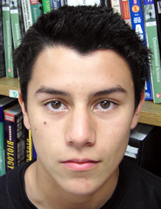
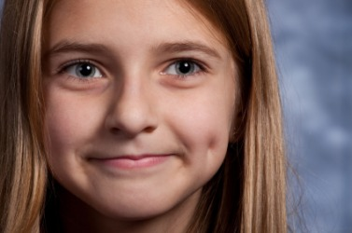
Widows Peak
Cheek Dimples

Slide 4
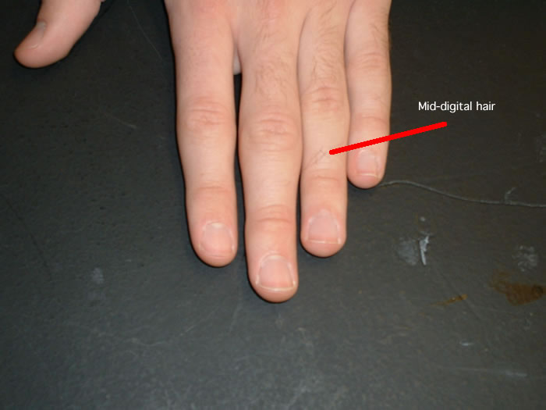
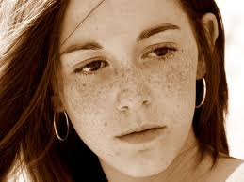
Face Freckles
Mid Digit Hair

Slide 5
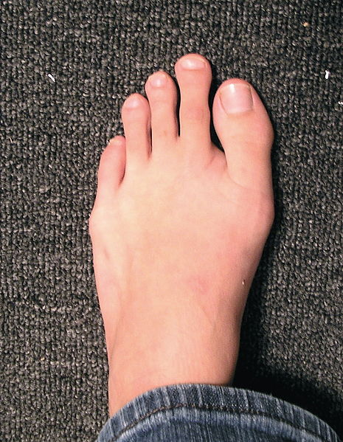

Hitch Hikers Thumb
Longer Second Toe

Slide 6
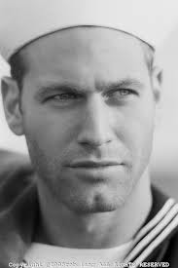
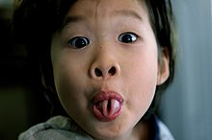
Tongue Rolling
Cleft Chin

Slide 7

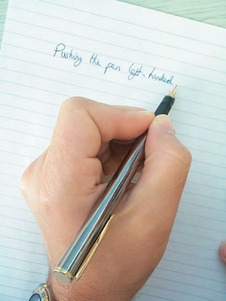
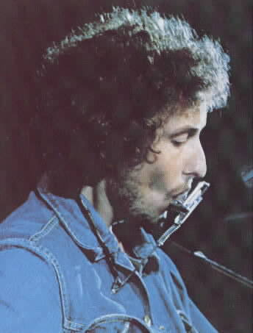
Roman Nose
Left/Right handed

Slide 8
Trait | Dominant Phenotype | Possible Dominant Genotypes | Recessive Phenotype | Recessive Genotype
ear lobes | free | LL or Ll | attached | ll
color of iris | not blue | EE or Ee | blue | ee
widow's peak | peak | PP or Pp | no peak | pp
cheek dimples | dimples | DD or Dd | not dimples | dd
face freckles | freckles | FF or Ff | no freckles | ff
mid-digital hair | hair | HH or Hh | no hair | hh
Hitchhiker's thumb | straight | TT or Tt | curved | tt
Hallux length (toes) | long 2nd toe | BB or Bb | long big toe or = to 2nd toe | bb
tongue rolling | ability | RR or Rr | no ability | rr
cleft chin | cleft | YY or Yy | no cleft | yy
Nose | Roman | NN or Nn | Normal | nn
Handeness | Right | WW or Ww | Left | ww
Notes:
Discrete – you either have it or you don’t
EXPT test class for presence of traits and work out genotype

